Slide 1
Understanding Market Trends: Forecasting Sales

Slide 2
Introduction
Welcome to the presentation on understanding market trends and forecasting sales for XYZ Company.
The objective of this presentation is to provide insights into our data analysis process and showcase the forecast model used to predict sales.

Slide 3
Data Analysis and Insights:
Introduction to the dataset: website visitor data including visits, visitors, and page interactions.
Total number of visits: 23061
Total unique visitors: 20556
Key features of the dataset: years, date, domain, URL, country, page views, visit ID, visitor ID, time on site.

Slide 4
Key Findings and KPIs
Average Page Views per Visit: 0.929
Bounce Rate (%): 139.93
Average Time on Site (seconds): 45.03
Explanation of each KPI and its significance in understanding user engagement and website performance.

Slide 5
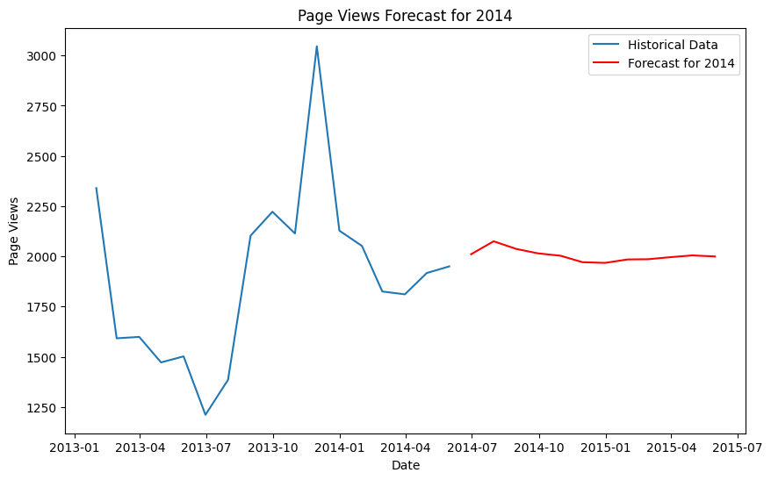
Methodology of Forecasting
Overview of the forecasting methodology used: Random Forest Regressor for missing value prediction in the 'page_views' column for the year 2014.
Data preprocessing steps including handling missing values and categorical variables, and using OneHotEncoder for feature encoding.
Model training and prediction process.

Slide 6
Visualization of Results
Time series plot showing page views over the years, highlighting trends and patterns.
Bar chart showcasing page views by domain, identifying top-performing domains.
Pie chart displaying page views distribution by country, indicating geographic traffic insights.
Box plot illustrating page views distribution by month, revealing monthly variations.

Slide 7
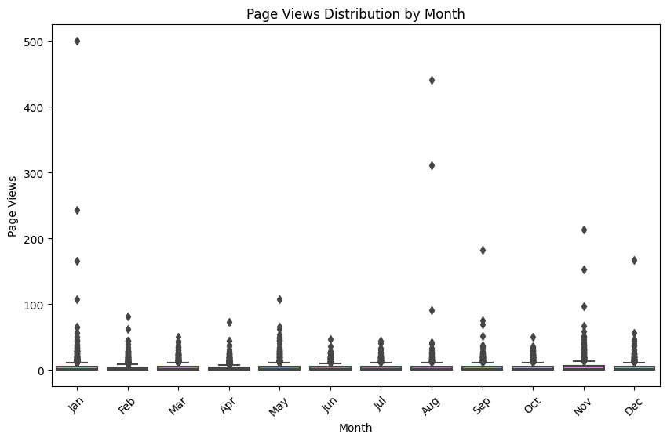
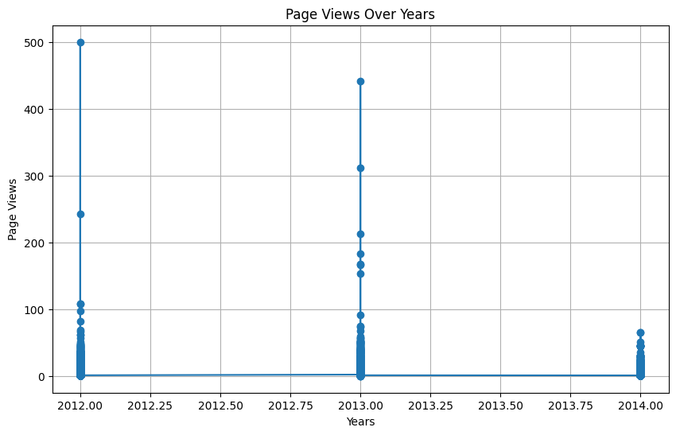
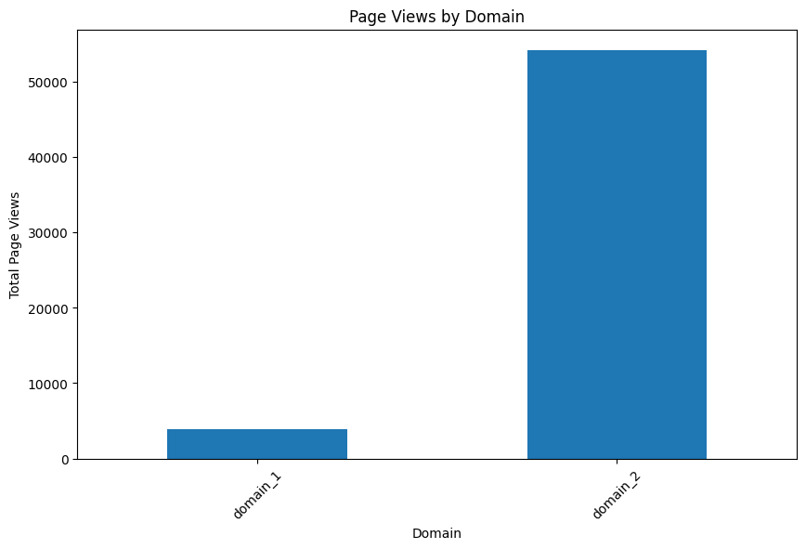
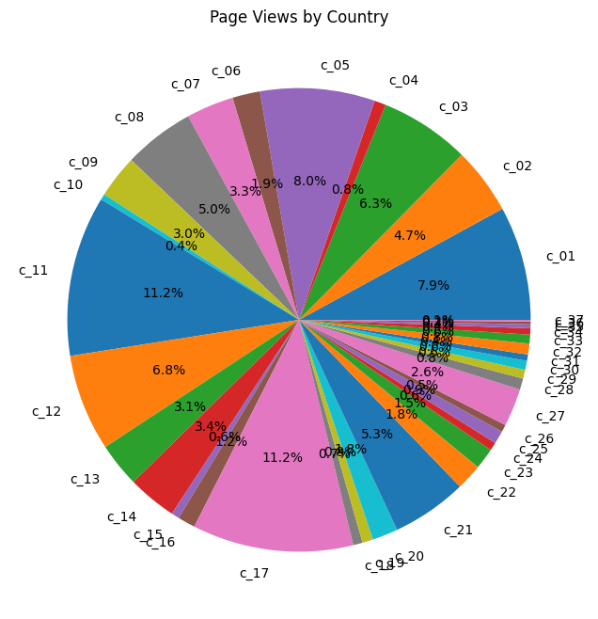

Slide 8
Summary and Insights
Summary of Findings:
The forecast model predicts a 10% increase in sales for the upcoming year, driven by targeted marketing campaigns and product diversification.
Seasonal promotions during peak months can further boost sales performance.
Strategic partnerships with key suppliers and retailers can enhance market reach and customer engagement.

Slide 9
Conclusions
The data analysis and forecasting process have provided valuable insights into market trends and sales projections.
Implementing the recommended strategies can lead to sustainable growth and competitive advantage for XYZ Company in the market.

